Slide 1

Covid-19 Spark - Submit Application
KEISHA COLEMAN
NICHOLAS FLINN
AMINA GULED

Slide 2
Tech Stack
Apache Spark
Spark SQL
YARN
HDFS
SBT
Scala
Git + GitHub
Zeppelin + Apple Numbers

Slide 3
Project Scope
In this project we will be uncovering the effects of GDP, resources, age and populations on a country’s mortality rate.
Understanding what causes high mortality rates in different countries can help us prevent deaths and save lives.
Notes:
Covid data was added to our HDFS and accessed by Apache Spark in order to answer this question. All queries were performed using Spark.SQL and visualized using Zepellin.
A total of 10 queries targeted toward this answer were processed using our data.

Slide 4
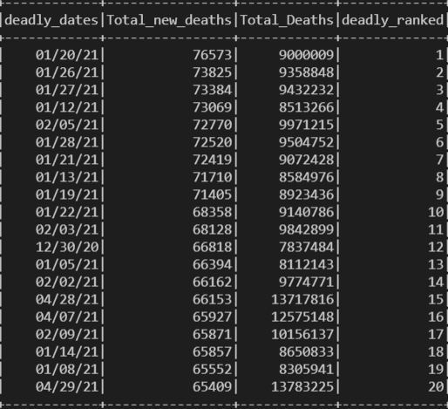
Most Fatal Days of Covid Globally
Most fatal month was January 2021
Notes:
Total deaths globally on the dates where the most new deaths were reported.
The most deadly month was Jan 2021 top 10 days all being in that month.
Interestingly it is a full year after the first cases were reported at the end of Dec 2019 in Wuhan.

Slide 5
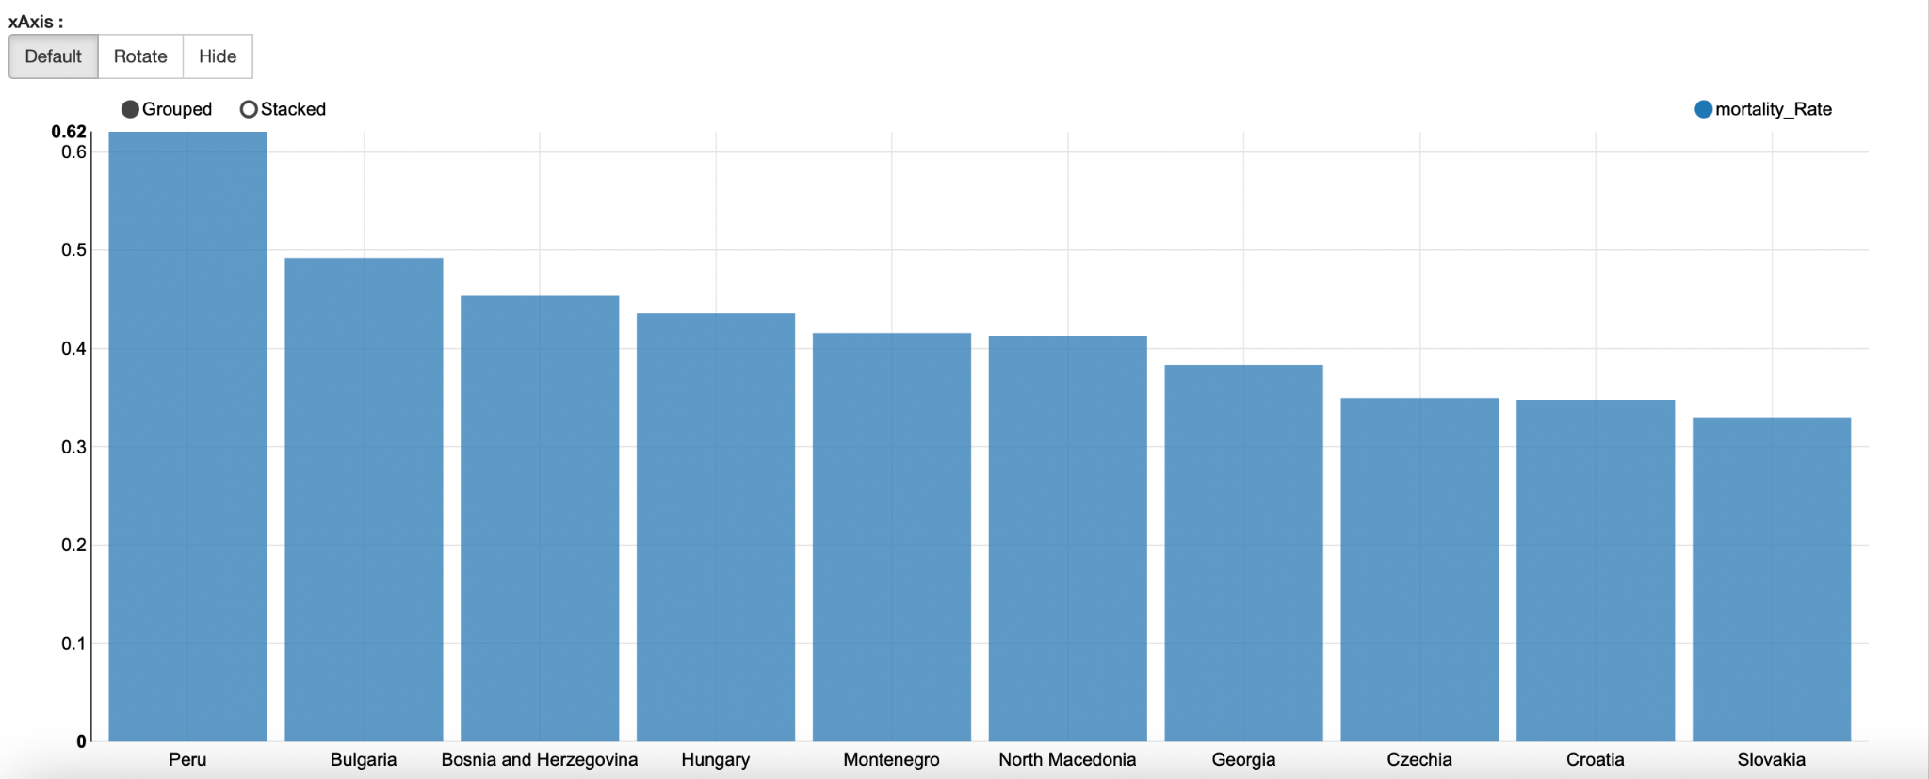
Top 10 Countries With Worst
Mortality Rate
countries with highest death rates.
Notes:
In the next few slides we will be observing the effects of GPD and Resources/infrastrucure on the death rates of a country.

Slide 6
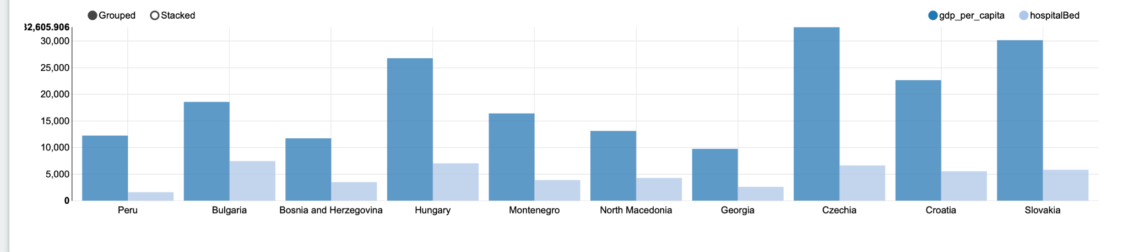
Hospital Beds vs GDP
GDP is directly proportional to resources.
Notes:
countries with more money can afford more hospitals and more hospital beds
from left to right
point out that some countries with high mortality rate also had comparably high GDP, but still fewer beds

Slide 7
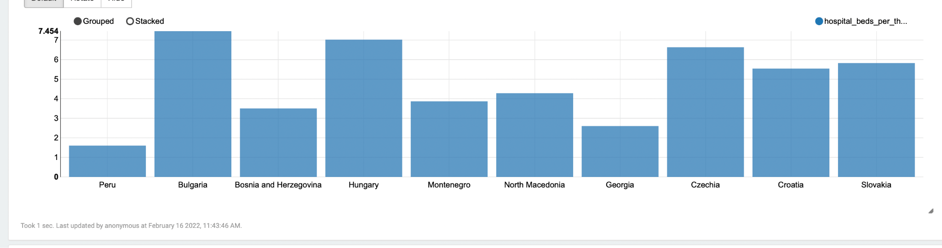
Hospital Beds vs Mortality Rates
hospital bed/resources per country.
Notes:
Peru has the highest mortality rate, and also the least amount hospital beds, leading us to believe the amount of resources does affect the mortality rate. although the trend isn’t consistent enough as we see with Bulgaria.
These countries had higher mortality rates and less beds when compared globally.

Slide 8
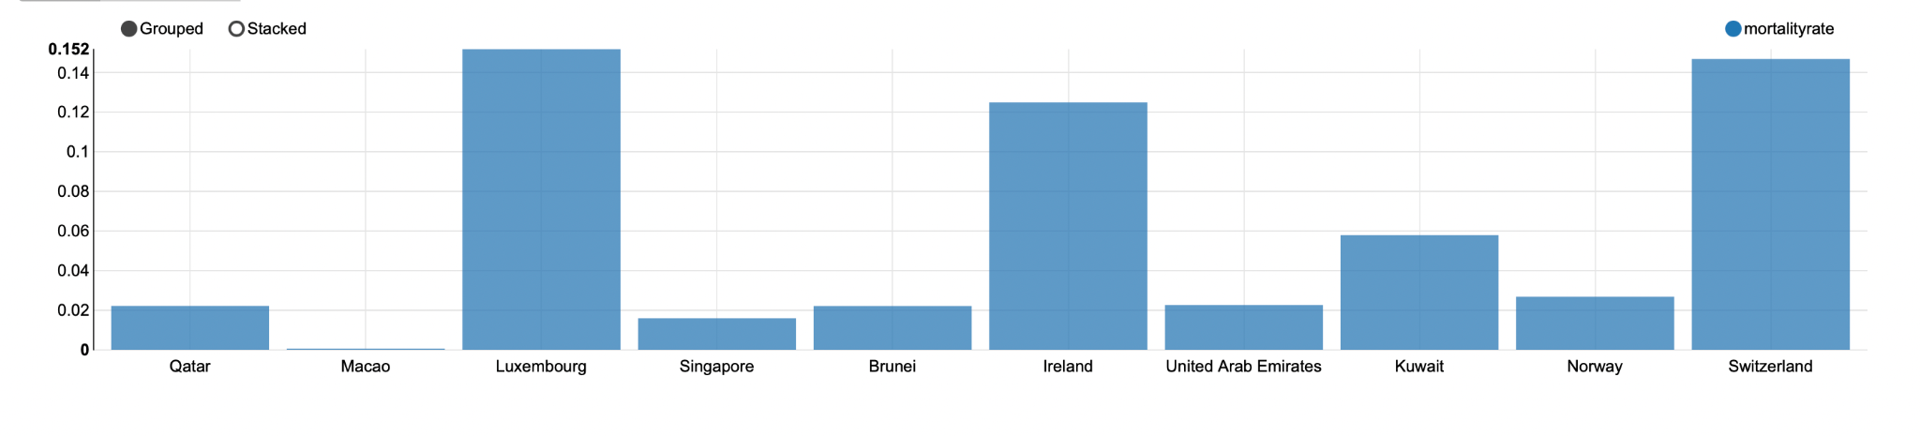
GDP vs Mortality Rates
top 10 countries with the highest GDP.
Notes:
These Countries do not have the lowest Mortality Rates nor is a trend present, leading us to believe that the country’s wealth alone is not enough to slow the Mortality rate of covid.
Richest from left to right

Slide 9
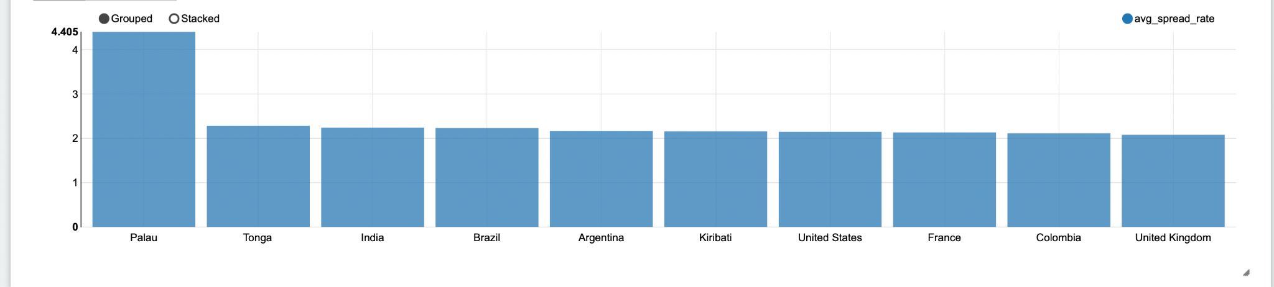
Countries with Highest Spread Rates
Notes:
Top 10 countries based on spread rate.
Spread rate was calculate for each day and country. The average for each country was calculated and is shown.
This means that these countries had the most new cases on average rather than the most cases in general.
Previous example looks only at who had highest peak of spread or most new cases compared to their toal cases.

Slide 10
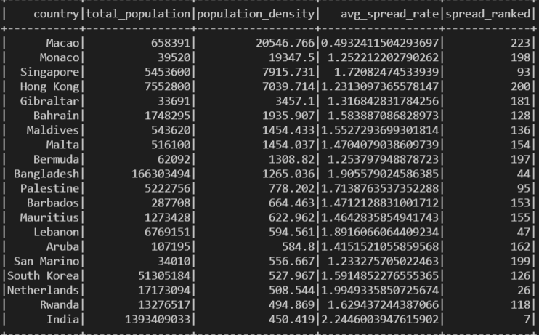
Does population density effect spread rate?
Notes:
Was population density a factor in the average spread rate?
Apparently not. Some of the most densely populated locations ranked fairly low globally for spread rate.
Anything Over 125 would be considered to report new cases the most frequently.

Slide 11
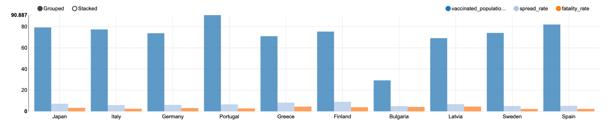
How did countries with older populations handle COVID?
Notes:
This shows the top countries by elderly population over 65.
Did these countries take care of their elders?
Most countries with elderly population did well in managing fatality and spread/new cases.
They also have some of the highest vaccinations.
An exception to this are countries in Eastern Europe in comparison to the other countries with large elderly populations did not handle spread and mortality as efficiently
For visualization purposes fatality and mortality were multiplied by 1000 to better compare them.

Slide 12
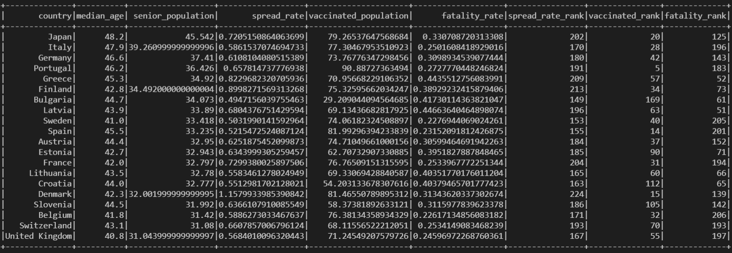
Senior Population Countries Ranked
For a more clear understanding of how they fit in globally.

Slide 13
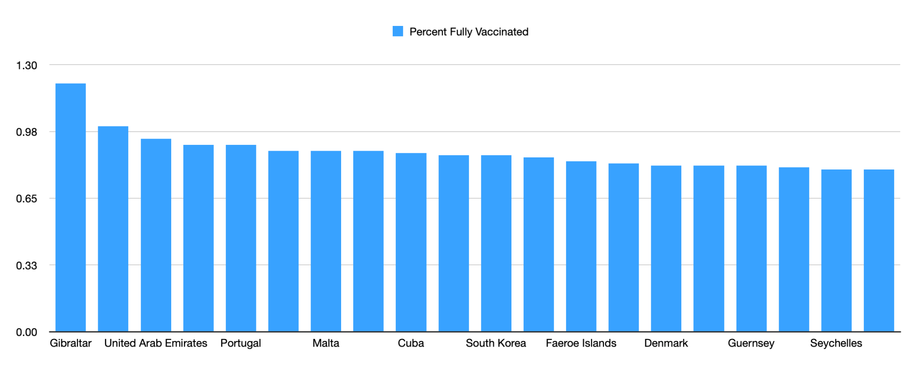
Recent infection rate with vaccines available - Highest
Countries with high fully vaxxed percentages generally do not have a high mortality rate
Notes:
The countries with a high fully vaxxed percentage are all over the map
They correspondingly do not seem to have a high mortality rate, according to our findings

Slide 14
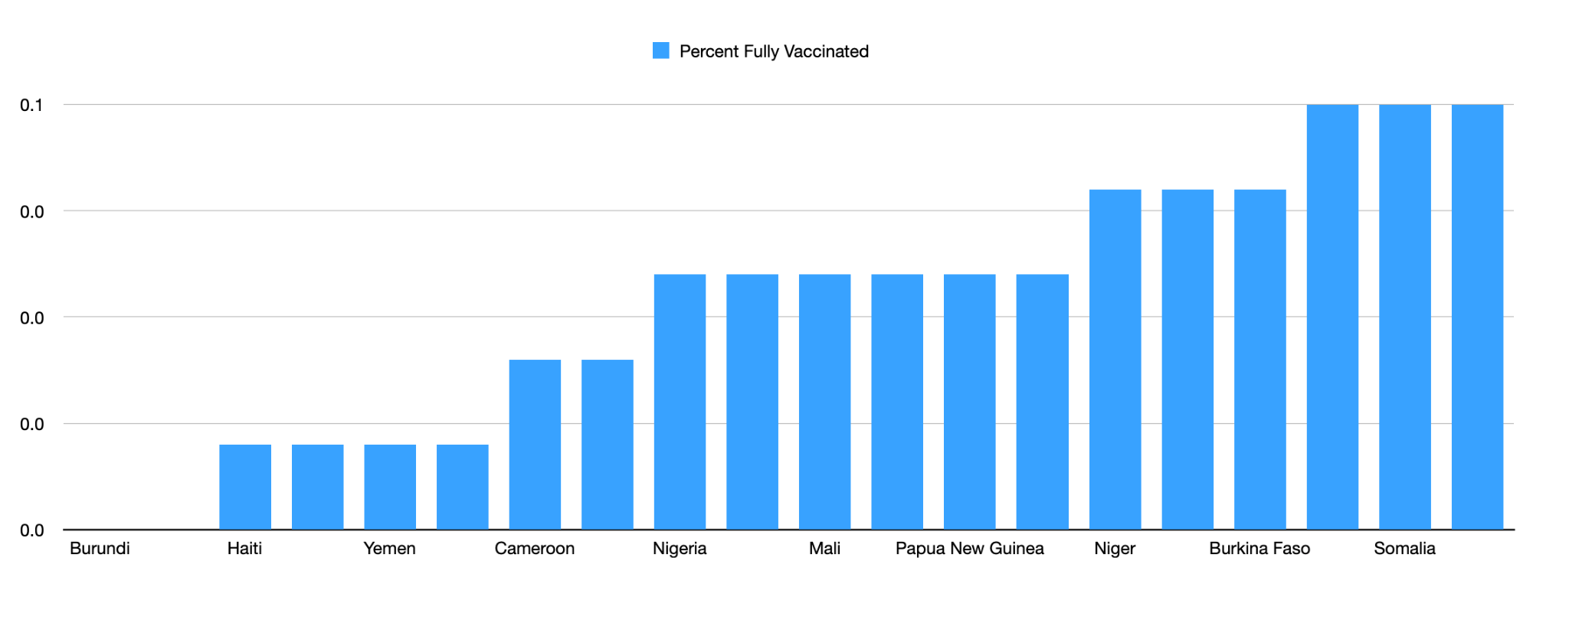
Recent infection rate with vaccines available -Lowest
There does not seem to be a direct correlation between low fully vaxxed percentages and mortality rate.
Notes:
There does not seem to be a direct correlation between low fully vaxxed percentages and mortality rate
We initially suspected that countries with low percentages would have correspondingly high mortality rates, but this is not reflected in the data
Many of the countries with low percentages are in Sub-Saharan Africa and West Asia
It is possible that these countries have had limited access to vaccine and comparatively limited exposure to infections

Slide 15
Trends Discovered
Solutions and data overarching conclusion write in notes add a covid/time graph here.
Seeing the effects that resources, age, GDP, and population have on mortality rate
Medical infrastructure seemed to have an impact
GDP had an indirect impact, as richer countries could afford more medical infrastructure
Most countries with elderly population did well in managing fatality, new cases, and vaccinations
No real evident correlation between vaccination percentages and mortality rate
No real evident correlation between population density and average spread rate

Slide 16

Thank You
GitHub: https://github.com/huckflinn/project-2
Questions ??????

